Slide 1

-By Aparna Uppala
HEART DISEASE DIAGNOSTIC - ANALYSIS

Slide 2
Introduction
The goal of this project is to analyze the heart disease occurrence, based on a combination of features that describes the heart disease
Health is real wealth in the pandemic time we all realized the brute effects of covid-19 on all irrespective of any status. You are required to analyze this health and medical data for better future preparation.
A dataset is formed by taking into consideration some of the information of 303 individuals.

Slide 3
Details of Data
age: The person's age in years
sex: The person's sex (1 = male, 0 = female)
cp: The chest pain experienced (Value 1: typical angina, Value 2: atypical angina, Value 3: non-anginal pain, Value 4: asymptomatic)
trestbps: The person's resting blood pressure (mm Hg on admission to the hospital)
chol: The person's cholesterol measurement in mg/dl
fbs: The person's fasting blood sugar (> 120 mg/dl, 1 = true; 0 = false)
restecg: Resting electrocardiographic measurement (0 = normal, 1 = having ST-T wave abnormality, 2 = showing probable or definite left ventricular hypertrophy by Estes' criteria)
thalach: The person's maximum heart rate achieved
exang: Exercise induced angina (1 = yes; 0 =no)
oldpeak: ST depression induced by exercise
relative to rest.
slope: the slope of the peak exercise ST
segment (Value 1: upsloping, Value 2: flat,Value 3: down sloping)
ca: The number of major vessels (0-3)
thal: A blood disorder called thalassemia (3 = normal; 6 = fixed defect; 7 = reversable defect)
num: Heart disease (0 = no, 1 = yes)

Slide 4
Main KPIs(Power BI)
Percentage of People Having Heart Disease
Age Distribution including Gender
Gender Distribution Based on Heart Disease
Chest Pain Experienced by People Suffering from Heart Disease
Blood Pressure, Cholesterol Level and Maximum Heart Rate of
People According to their Age and Heart Disease Patients
ST Depression Experienced by People According to their age and
heart disease.

Slide 5
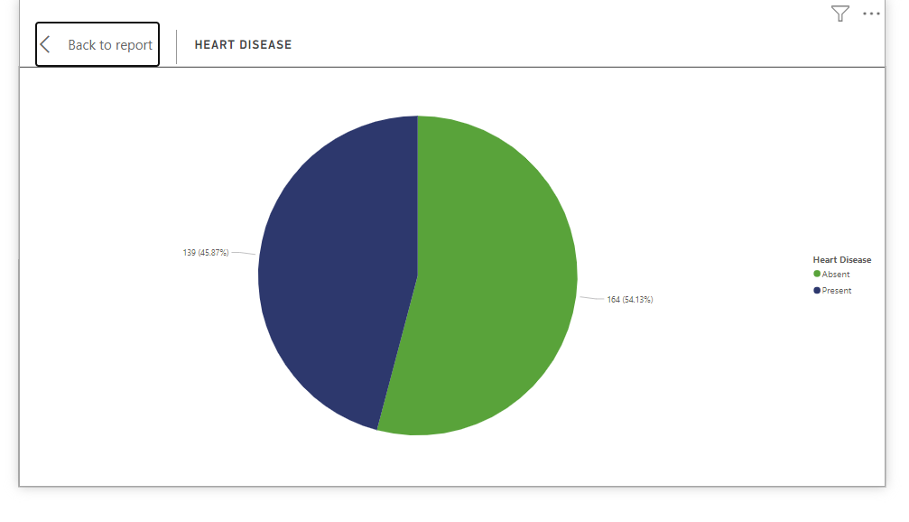
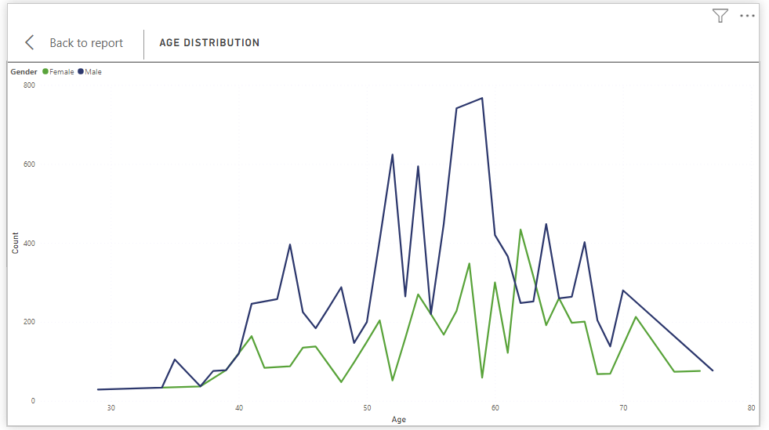
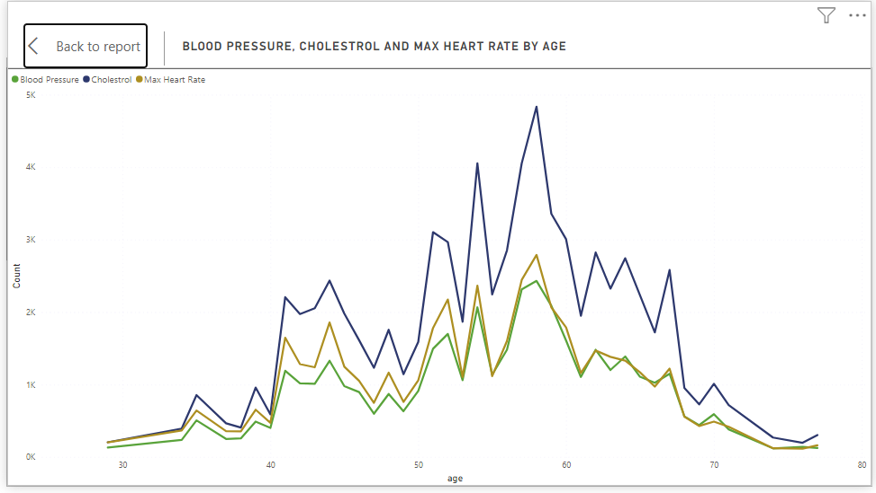
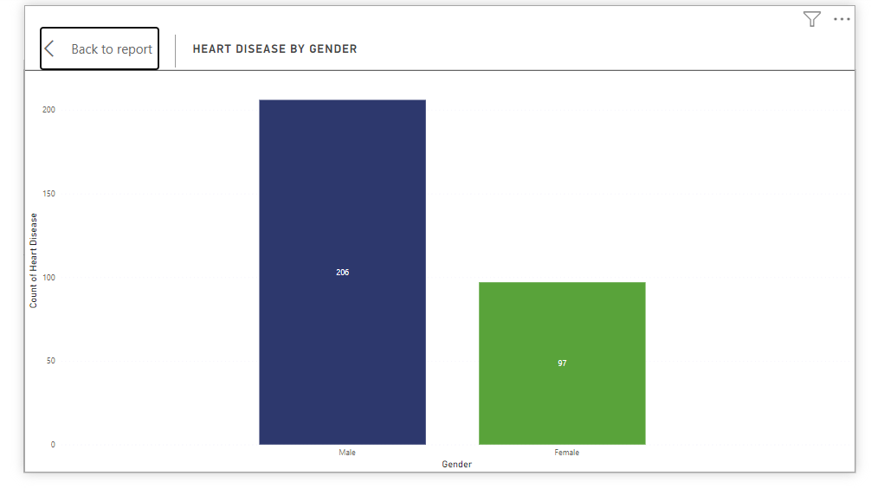
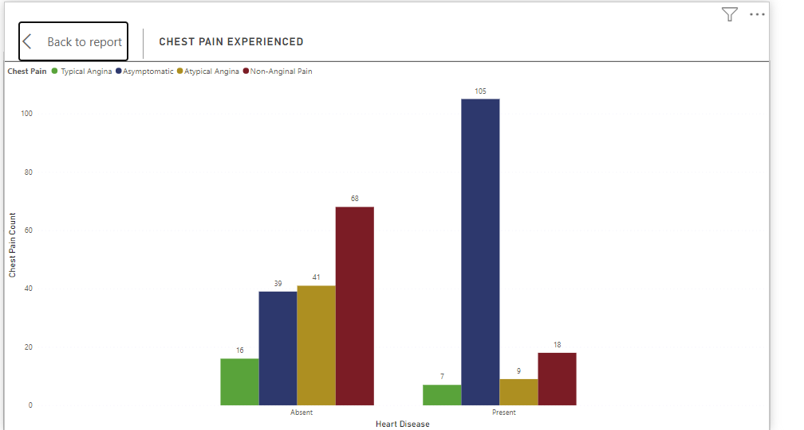
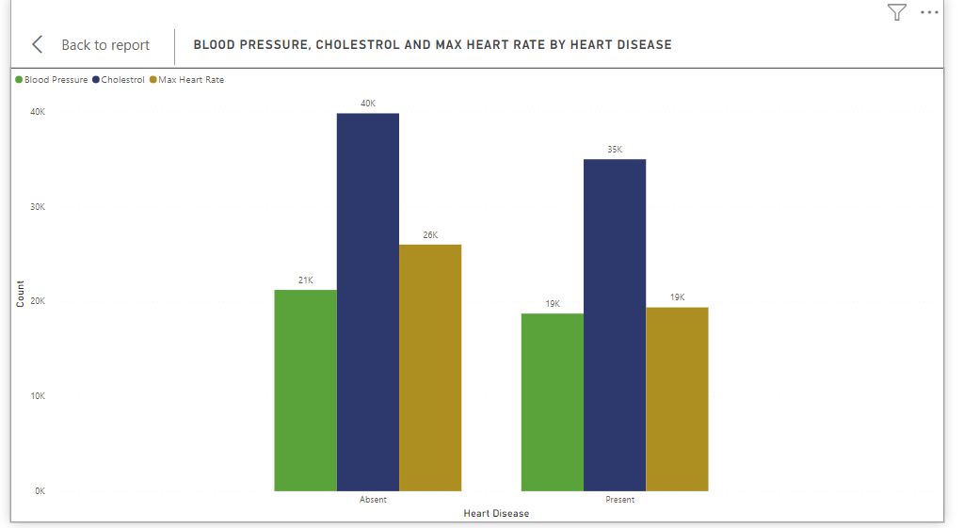
Insights

Slide 6
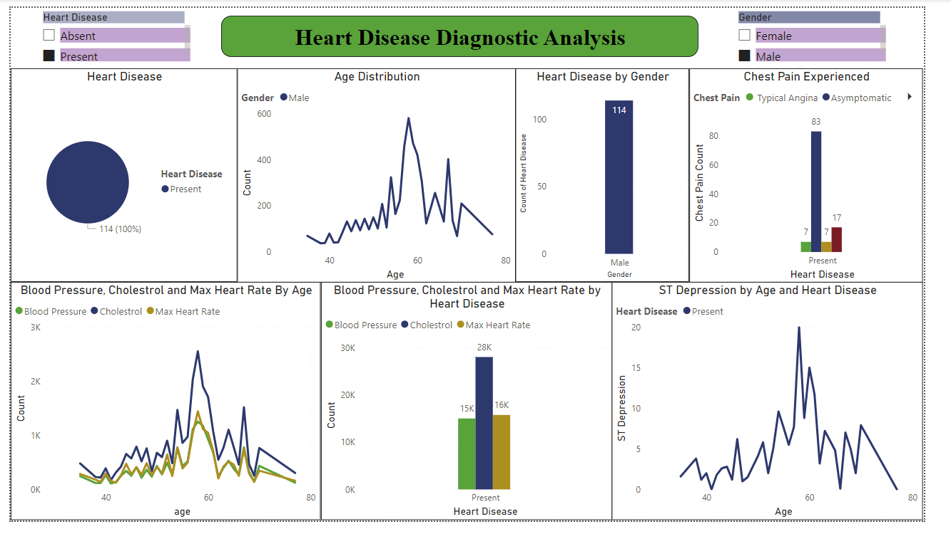
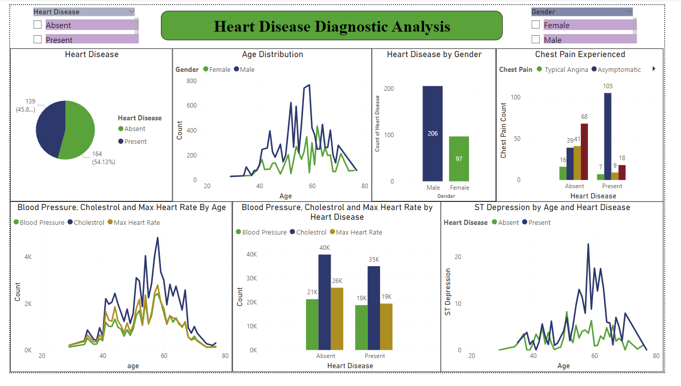
My Design(Dashboard)

Slide 7
Thank you

